Slide 1
SOAP
Qais Qaisi
6/26/2021

Slide 2
What is SOAP?
SOAP :is an acronym for Simple Object Access Protocol. but in later times was just shortened to SOAP v1.2. SOAP
SOAP :is an XML-based protocol for accessing web services over HTTP. It has some specification which could be used across all applications
https://en.wikipedia.org/wiki/SOAP

Slide 3
History Of SOAP
SOAP released as XML-RPC in June 1998 as part of Frontier 5.1 by DaveWiner, Don Box, Bob Atkinson, and Mohsen Al-Ghosein for Microsoft
XML-RPC is Remote procedure call Protocol
Microsoft Saw that this protocol as an essential part of scaling up its efforts in business-to-business e-commerce.
https://en.wikipedia.org/wiki/XML-RPC#History

Slide 4
Why we need SOAP
It is important for web applications to be able to communicate
over the Internet.
The best way to communicate between applications is over HTTP,
because HTTP is supported by all Internet browsers and servers.
SOAP was created to accomplish this.
SOAP provides a way to communicate between applications
running on different operating systems, with different
technologies and programming languages.
https://en.wikipedia.org/wiki/XML-RPC#History

Slide 5
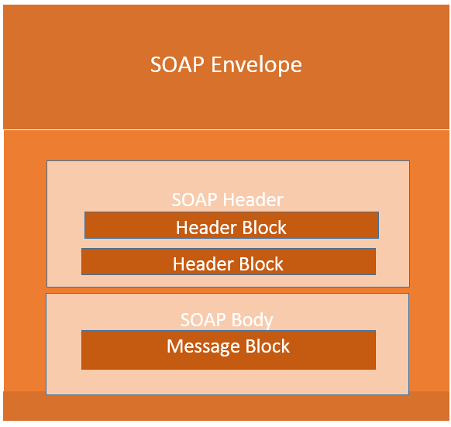
SOAP Building Blocks
The SOAP specification defines something known as a "SOAP message" which is what is sent to the web service and the client application.
https://www.guru99.com/soap-simple-object-access-protocol.html#1

Slide 6
SOAP Message Structure
One thing to note is that SOAP messages are normally auto-generated by the web service when it is called.
Whenever a client application calls a method in the web service, the web service will automatically generate a SOAP message which will have the necessary details of the data which will be sent from the web service to the client application.
https://www.guru99.com/soap-simple-object-access-protocol.html#1

Slide 7
SOAP Elements
The Envelope element
The header element and
The body element
T
he Fault element (Optional)
https://www.guru99.com/soap-simple-object-access-protocol.html#1

Slide 8
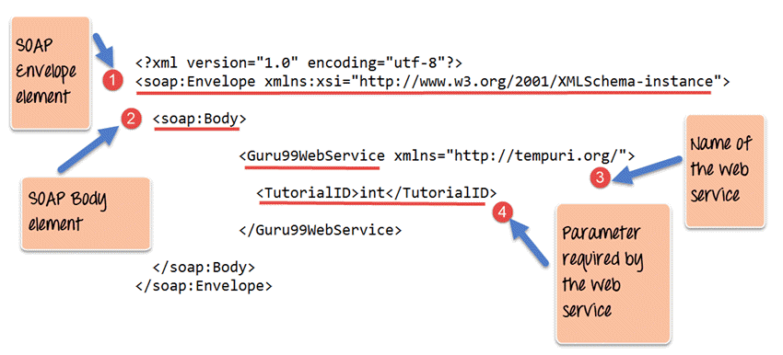
SOAP Elements
https://www.guru99.com/soap-simple-object-access-protocol.html#1

Slide 9
SOAP Elements
Every SOAP message needs to have a root Envelope element. It is absolutely mandatory for SOAP message to have an envelope element.
Every Envelope element needs to have at least one soap body element.
If an Envelope element contains a header element, it must contain no more than one, and it must appear as the first child of the Envelope, before the body element.
https://www.guru99.com/soap-simple-object-access-protocol.html#1

Slide 10
SOAP Elements
When a request is made to a SOAP web service, the response returned can be of either 2 forms which are a successful response or an error response. When a success is generated, the response from the server will always be a SOAP message. But if SOAP faults are generated, they are returned as "HTTP 500" errors.
https://www.guru99.com/soap-simple-object-access-protocol.html#1

Slide 11
SOAP Communication Model
All communication by SOAP is done via the HTTP protocol. Prior to SOAP, a lot of web services used the standard RPC (Remote Procedure Call) style for communication. This was the simplest type of communication, but it had a lot of limitations.
https://infostride.com/what-is-soap/

Slide 12
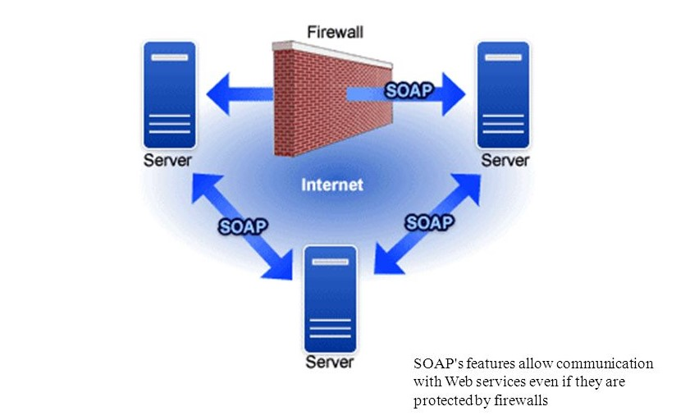
SOAP Communication Model
https://infostride.com/what-is-soap/

Slide 13
SOAP Challanges
Not Language Independent – The server hosting the methods would be in a particular programming language and normally the calls to the server would be in that programming language only.
Not the standard protocol – When a call is made to the remote procedure, the call is not carried out via the standard protocol. This was an issue since mostly all communication over the web had to be done via the HTTP protocol.
Firewalls – Since RPC calls do not go via the normal protocol, separate ports need to be open on the server to allow the client to communicate with the server. Normally all firewalls would block this sort of traffic, and a lot of configuration was generally required to ensure that this sort of communication between the client and the server would work.
https://www.guru99.com/soap-simple-object-access-protocol.html#7

Slide 14
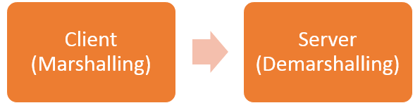
SOAP Challanges
To overcome all of the limitations cited below, SOAP would then use the below communication model
The client would format the information regarding the procedure call and any arguments into a SOAP message and sends it to the server as part of an HTTP request. This process of encapsulating the data into a SOAP message was known as Marshalling.
The server would then unwrap the message sent by the client, see what the client requested for and then send the appropriate response back to the client as a SOAP message. The practice of unwrapping a request sent by the client is known as Demarshalling.
https://www.guru99.com/soap-simple-object-access-protocol.html#7

Slide 15
Thank you
Resources
https://www.guru99.com/soap-simple-object-access-protocol.html#7
https://infostride.com/what-is-soap/
https://www.guru99.com/soap-simple-object-access-protocol.html#1
https://en.wikipedia.org/wiki/XML-RPC#History
https://en.wikipedia.org/wiki/SOAP
https://www.guru99.com/soap-simple-object-access-protocol.html#7

